Slide 1
Donic the ledgehog
Christo Stephenson
Kye horbury
Rory lowe-mcloughlin

Slide 2
General Implementation
Coded in C++ so classes can be used to improve modularity
Collision detection is a mix of bounding spheres and sphere to an axis-aligned plane detection
The main ‘client’ program modifies the behaviour of the ball
‘Game objects’ such as platforms, coins, etc. are self-managed
Designed to promote modularity and easy tweaking, through use of game objects, abstract classes and #define macros
Animations and physics are dependent on the time between frames to improve program consistency

Slide 3
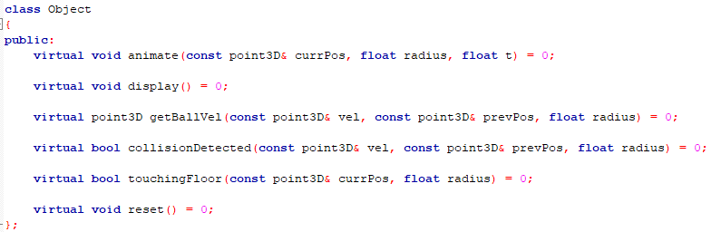
Game objects
Everything that interacts with the ball is defined as a ‘game object’ and are initialised globally
Pointers to objects are stored in the vector called ‘objects’
These objects behave like their own small OpenGL programs
These objects also tell the main client program what velocity they wish to be applied to the ball

Slide 4
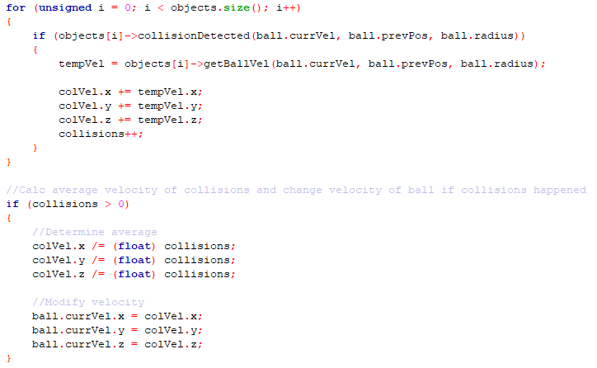
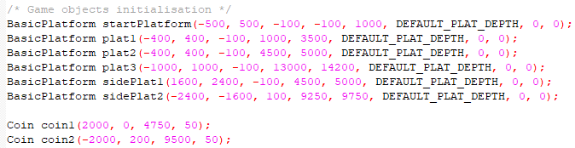
Game objects cont.

Slide 5
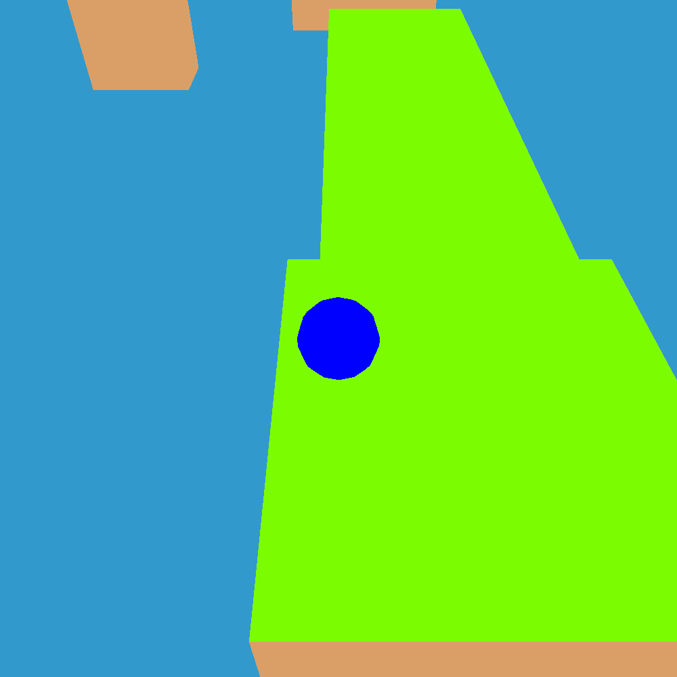
Ball movement
Using the WASD keys, you can move the ball in any direction, with W moving the ball and camera positive on the z axis, A negative on the z-axis etc…
General acceleration in every direction is also applied to the ball, such as gravity
Velocity determined by previousVelocity + (ballMovementAcc + ballGeneralAcc) * millisecondsSinceLastTick
Position determined by previousPosition + currentVelocity * millisecondsSinceLastTick
Ball movement acceleration is applied when the relevant key is pressed (e.g. a applies negative x movement acceleration)
Air resistance is applied by multiplying the velocity by the air resistance coefficient
Ball velocity in any direction is limited to a constant to prevent ridiculous amount of acceleration
Ball is rotated proportionally to the ball’s velocity on an axis

Slide 6
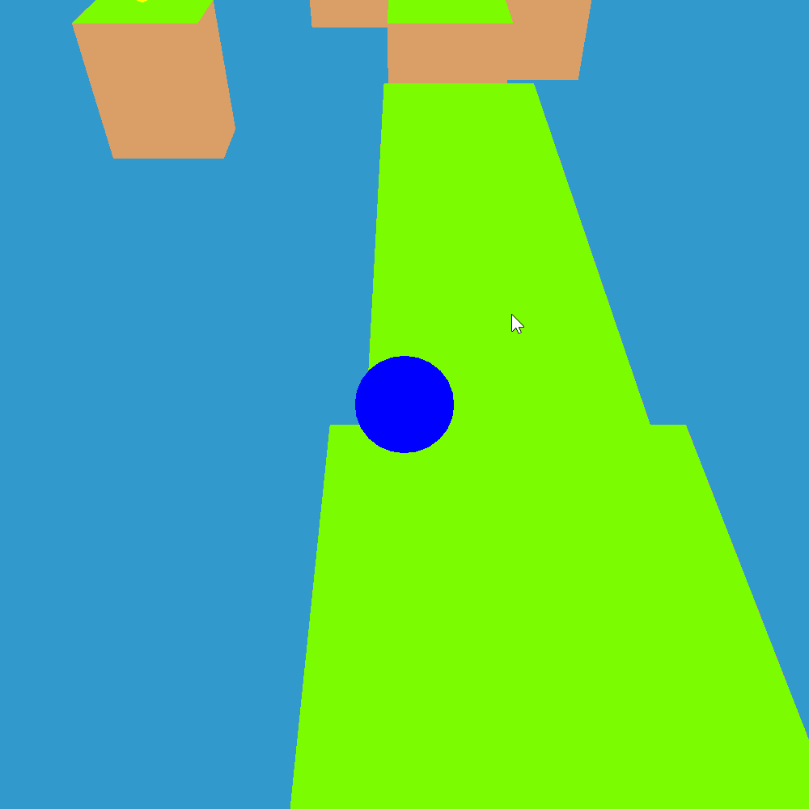
Ball jump
Press the spacebar to jump!
The longer you hold the spacebar down the higher you go, to a cap height.
When spacebar is pressed, checks that the ball is touching the ground of an object
Applies jump acceleration to current velocity when the spacebar is held down until the ball’s height reaches maximum height or when the user lets go of spacebar

Slide 7
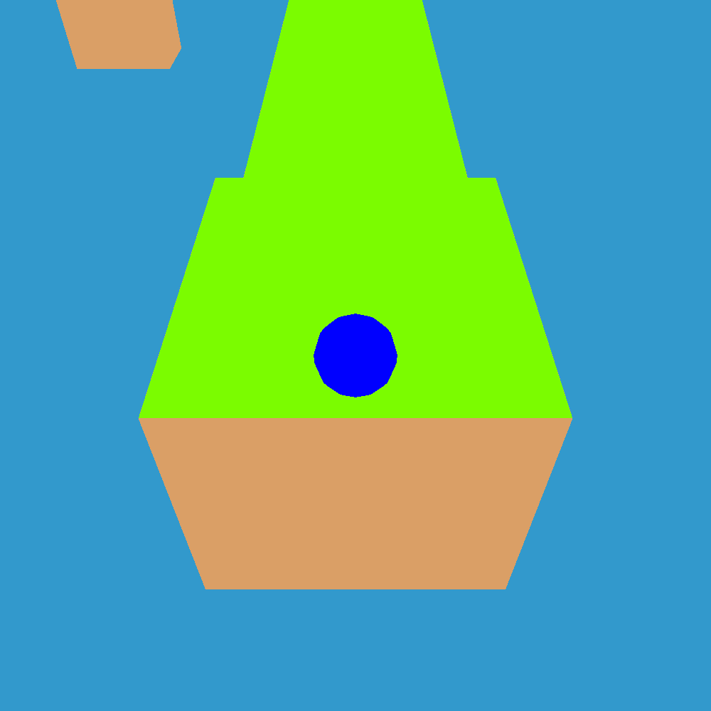
camera
Fixed and follows the ball

Slide 8
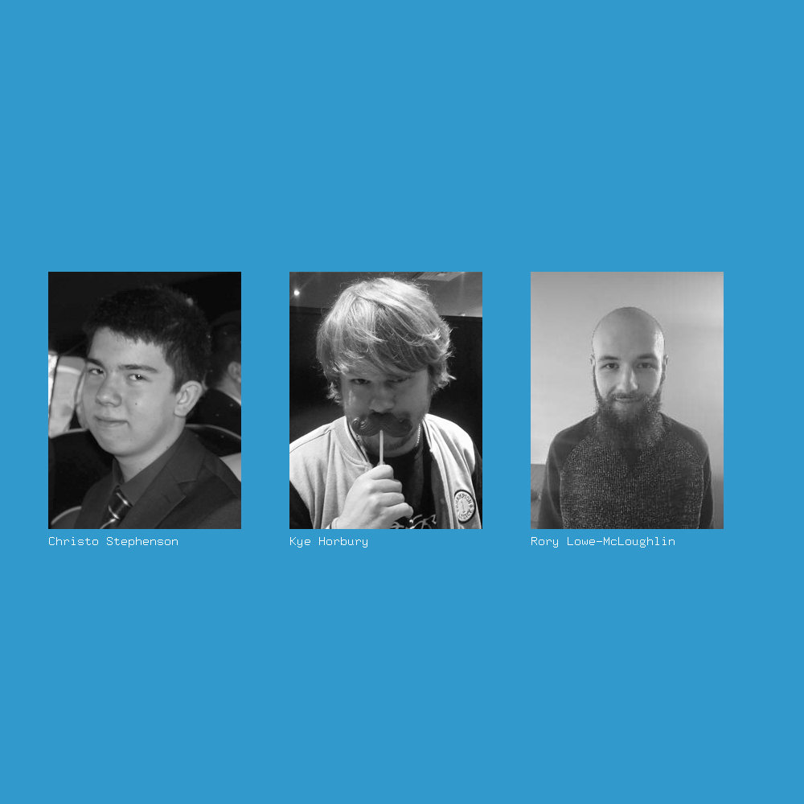
Additional inputs
Pressing ‘q’ resets the level
Pressing ‘p’ displays the developers of the project then quits the program
Pressing ‘n’ simulates wind by changing the general acceleration of the ball
Pressing ‘m’ turns on moon jump cheat code, enabling the max jump height to be increased

Slide 9
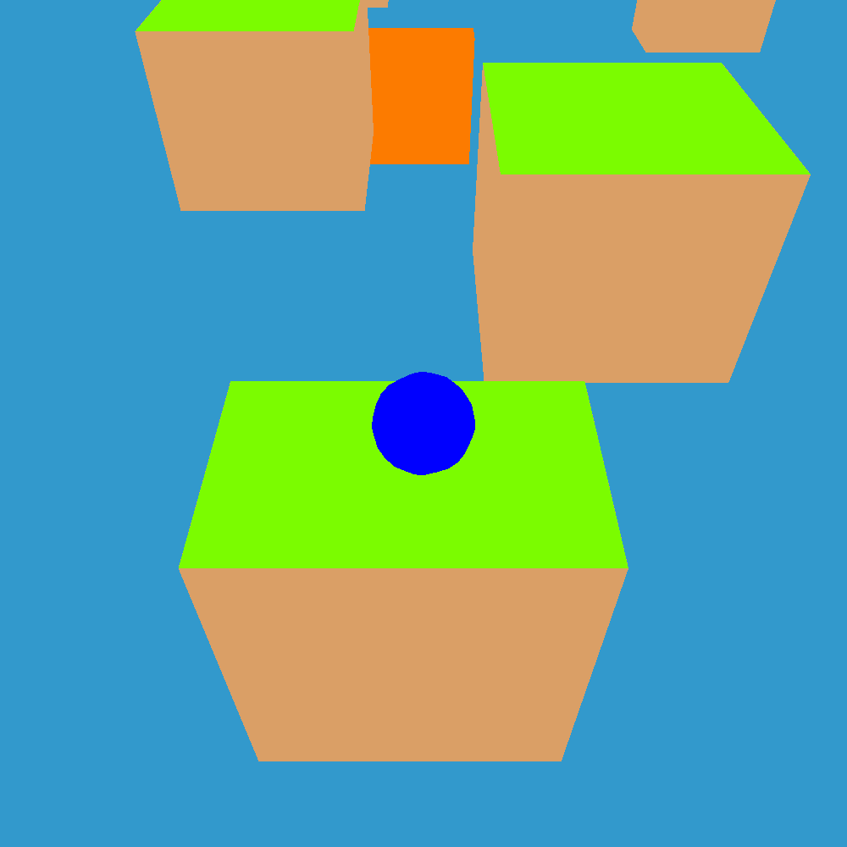
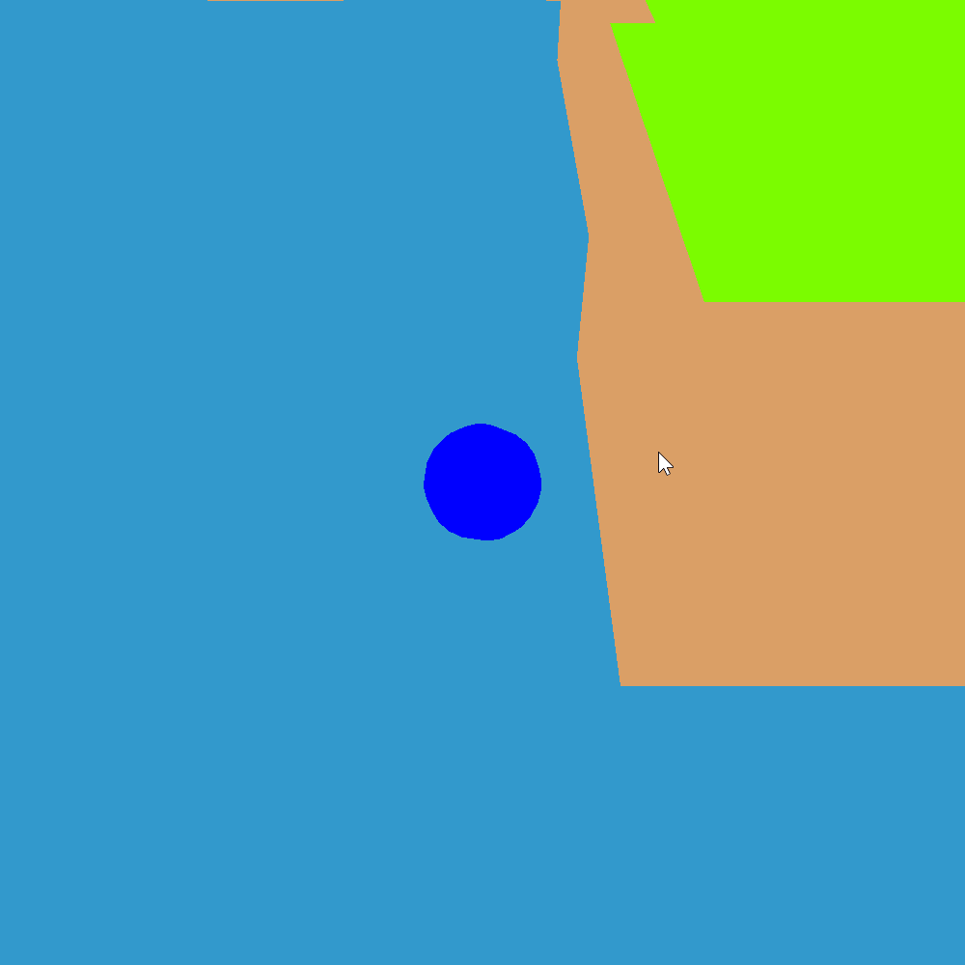
Platform/wall collision
If the ball hits a platform or wall, the ball cannot go through it
If the ball goes off the edge, it falls off.
If the ball’s position goes below a constant y value, the game resets
Each ‘surface’ of a platform or wall detects if the ball is touching the surface
‘surfaces’ of a platform are wrapped within an object
Surfaces predict where a ball should go upon collision
Objects take an average collision velocity of the surfaces within
The client program takes an average collision velocity of the game objects and applies it to the ball’s velocity

Slide 10
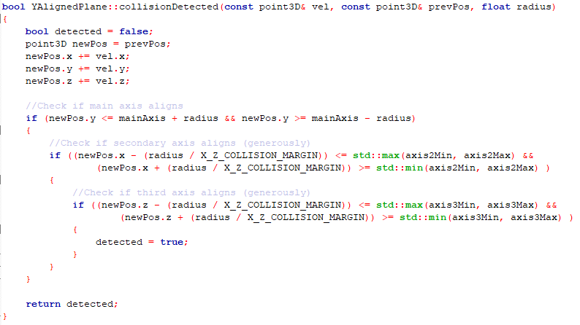
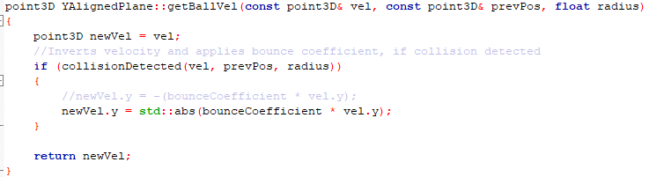

Slide 11


Slide 12
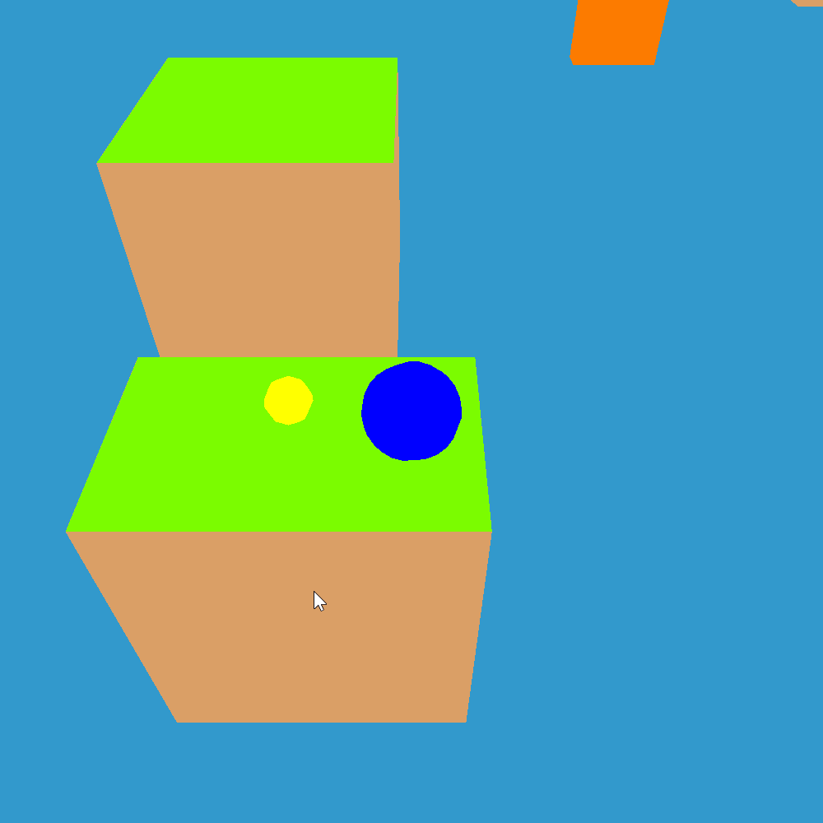
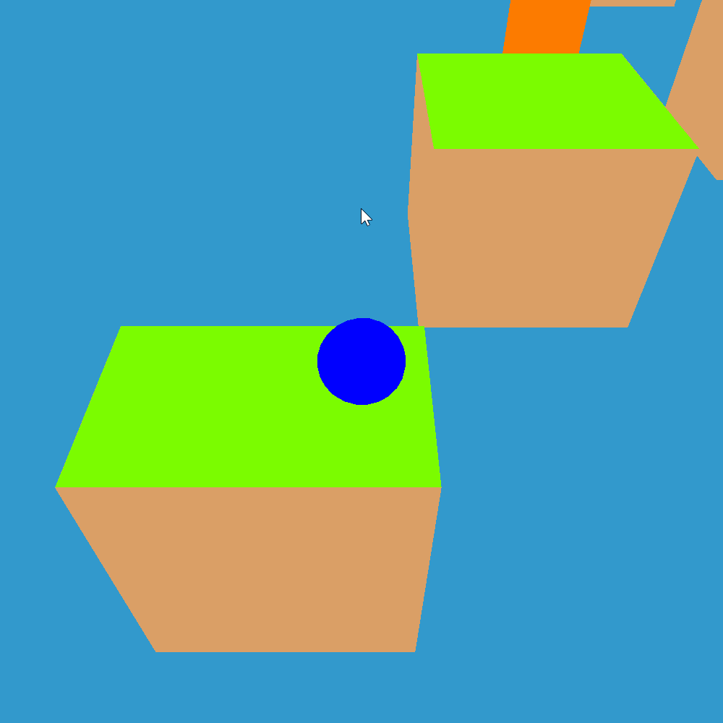
Coins
Coins can be collected across various platforms
Once a coin has been collected, they disappear until the game is reset
Uses bounding spheres detection

Slide 13
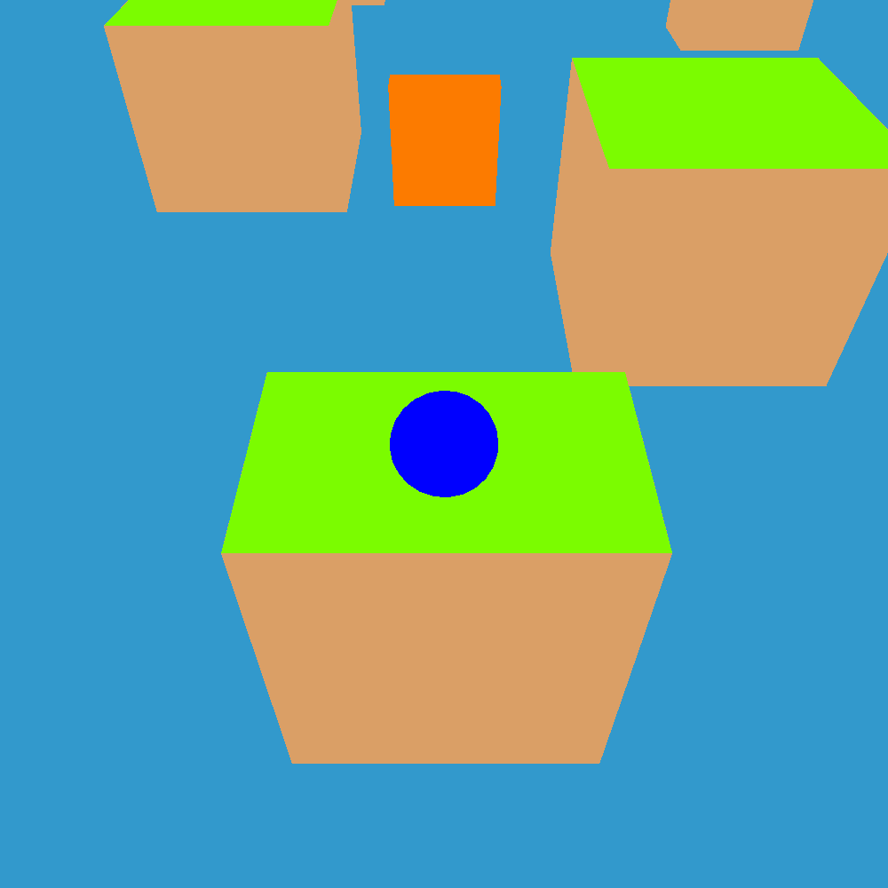
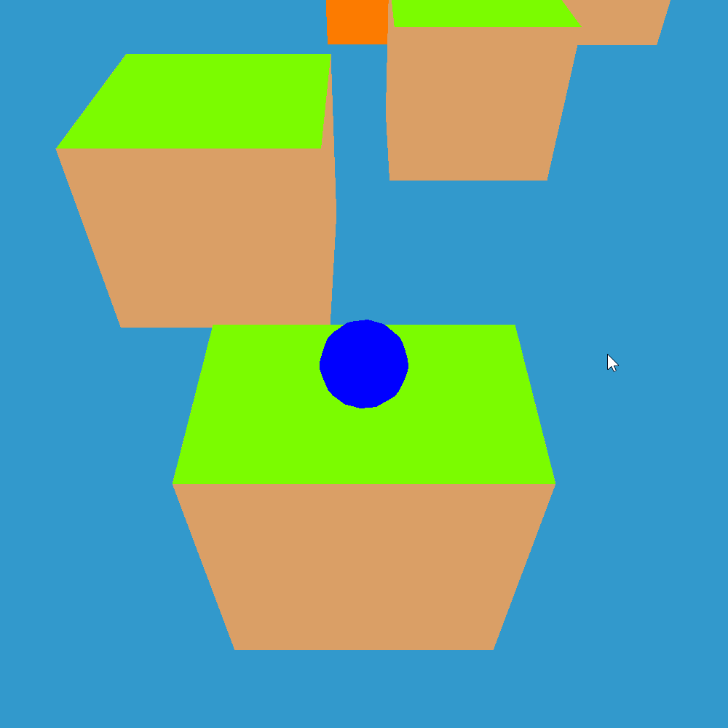
Moving platforms
Some platforms automatically move in a predicated pattern
These help you get through the course
Uses same collision detection as other platforms
Movement determined through each platform’s animate() method

Slide 14
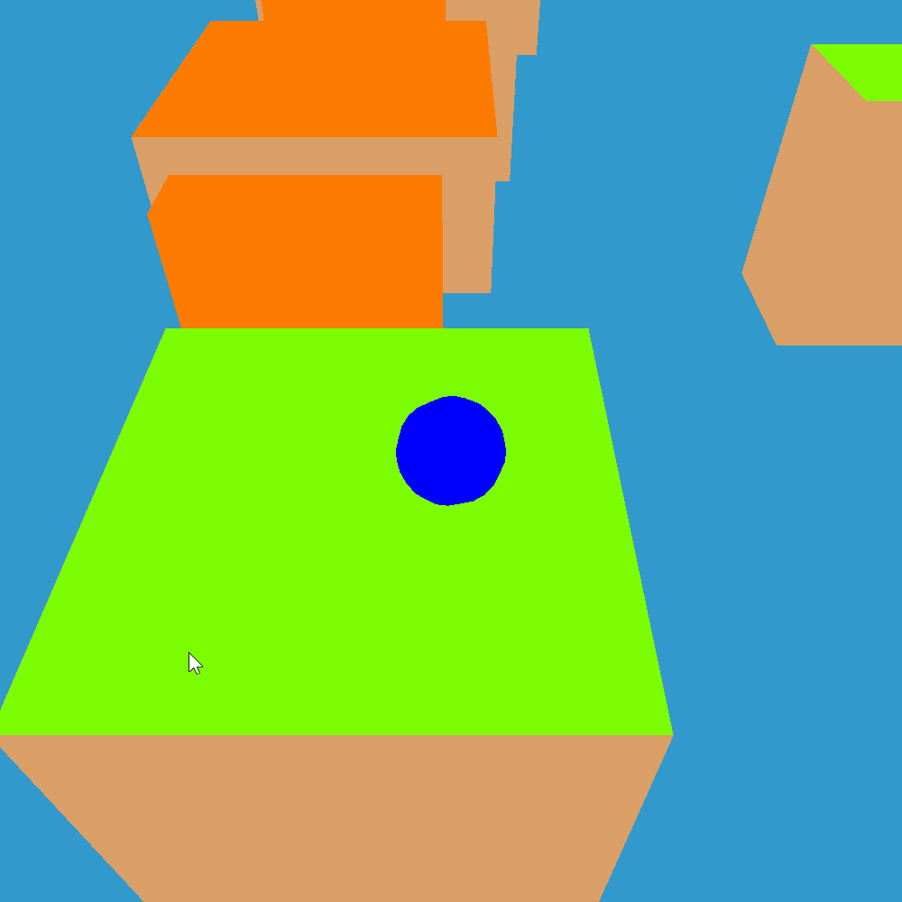
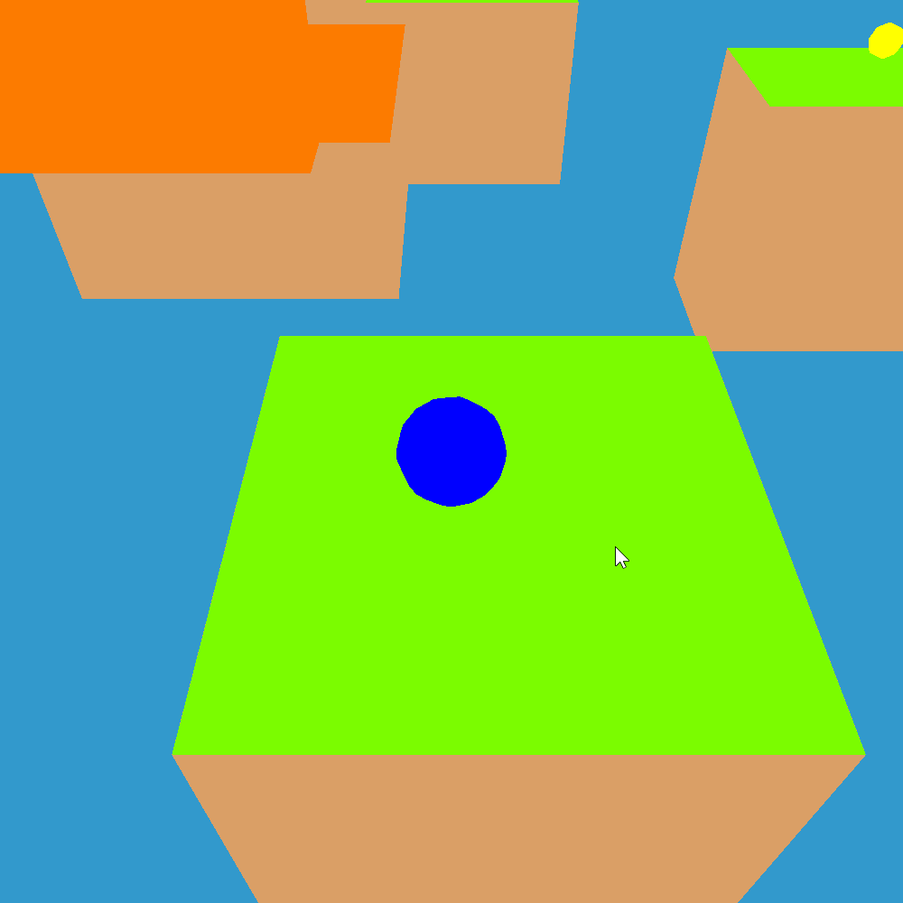
Moving wall
These walls are similar to the moving platforms, but hinder your progress instead of helping
Uses collision detection similar to normal platforms
Movement determined by animate() method of the wall
Parameters of the wall’s size, movement speed, movement distance and initial direction is determined in the wall’s constructor

Slide 15
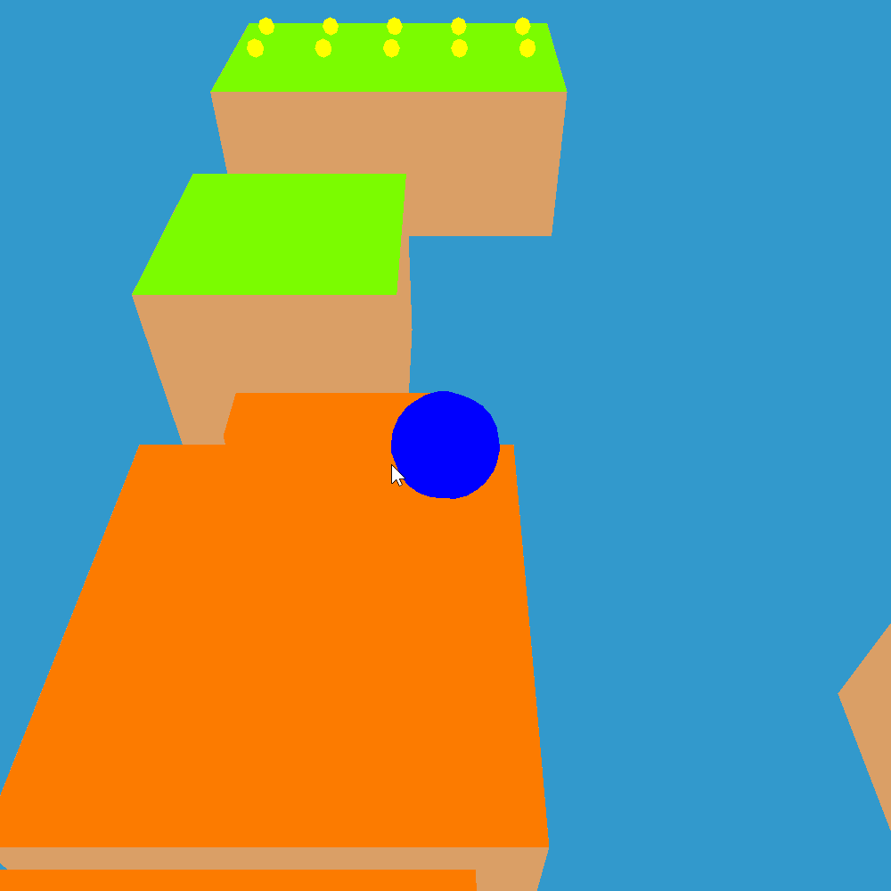
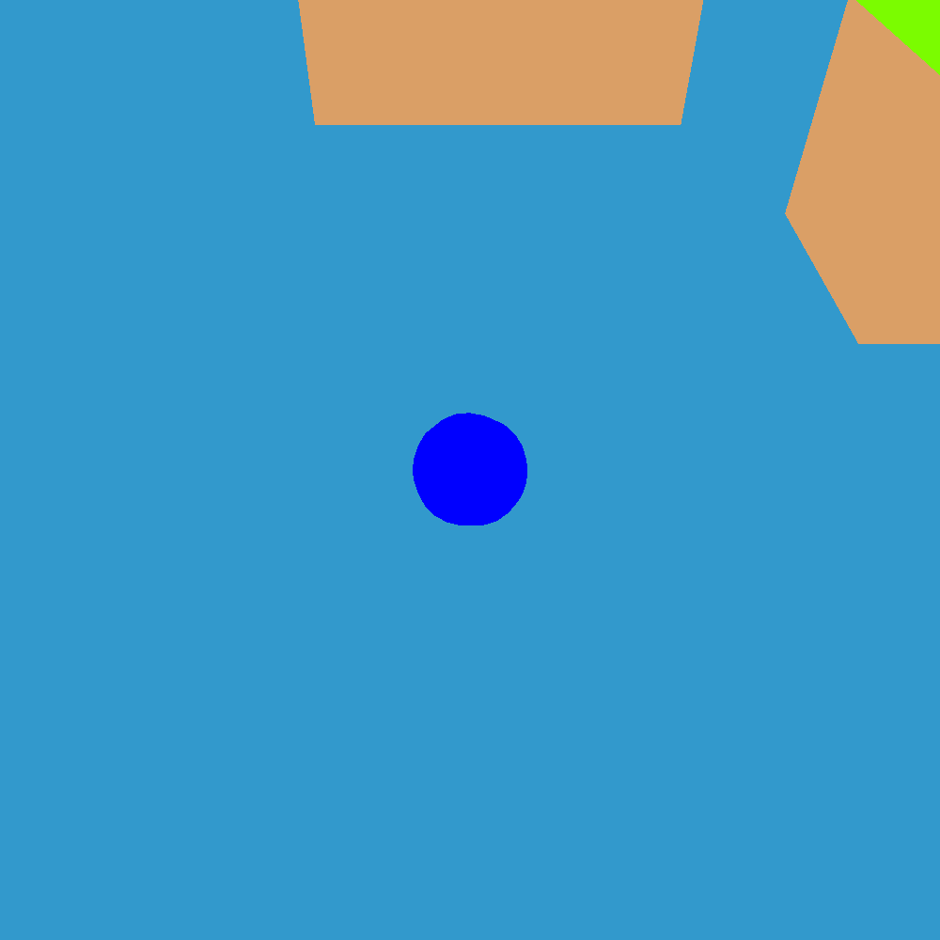
Disappearing platform
Some platforms if you touch will start flashing quickly in different colours.
After a certain amount time , the platform will disappear
Collision detection is the same as other platforms
Platform checks if the ball is touching the platform in the animate() method, then issues the platform to flash different colours and be destroyed after a time set in the disappearing platform’s constructor

